Slide 1
Build Basic Generative Adversarial Networks GANs
17/04/2024

Slide 2
Course Overview
This course is designed for everyone, including professionals, executives, students, and enthusiasts, interested in learning about generative AI and leveraging its capabilities in their work and lives.
This course is your first step toward understanding the capabilities of generative AI, powered by different models, including large language models.

Slide 3
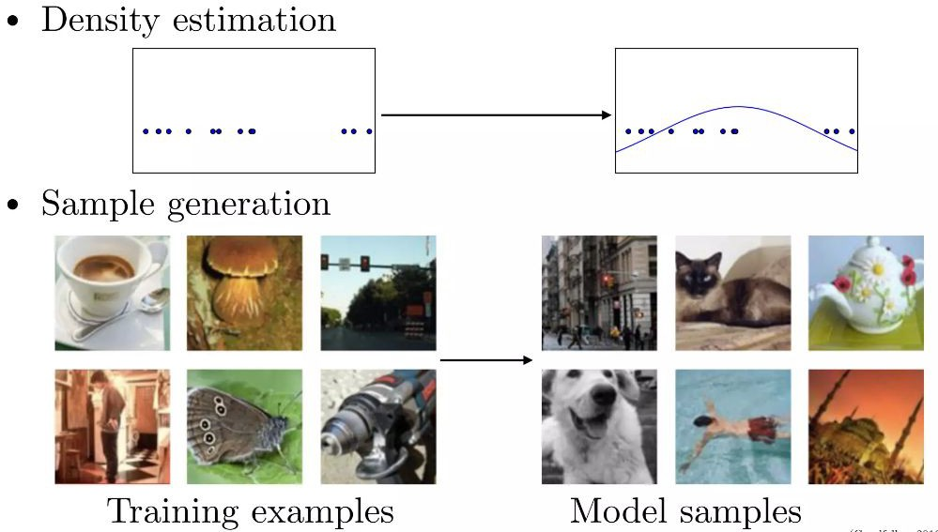
Generative Modeling

Slide 4
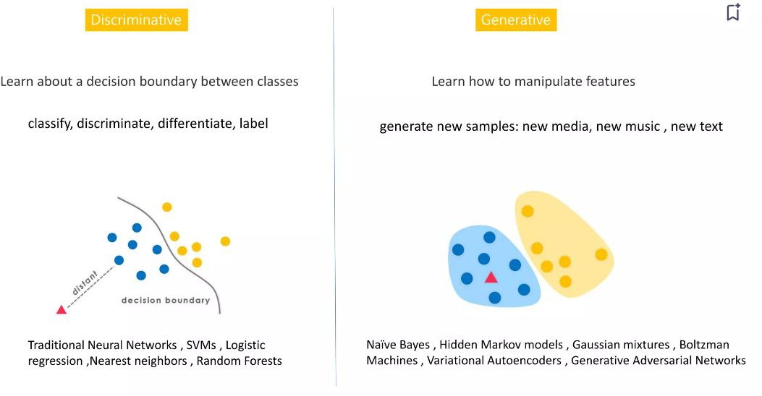

Slide 5
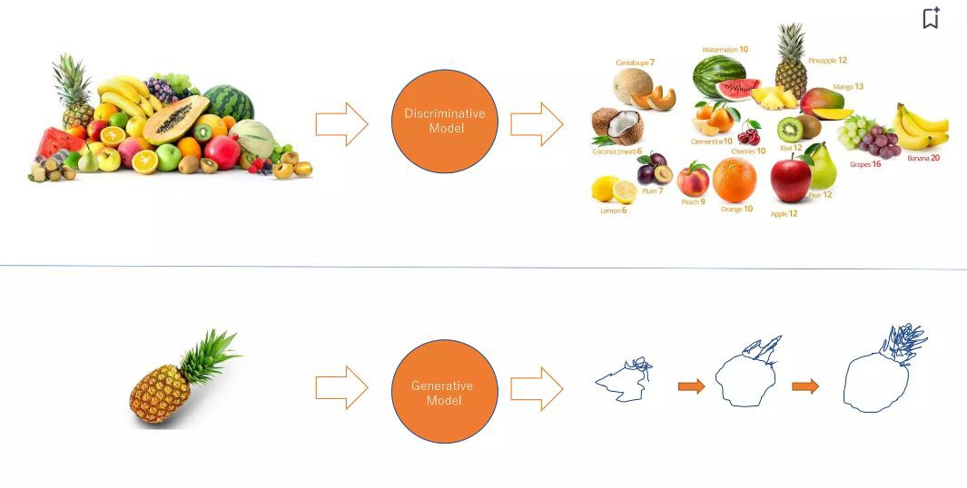

Slide 6
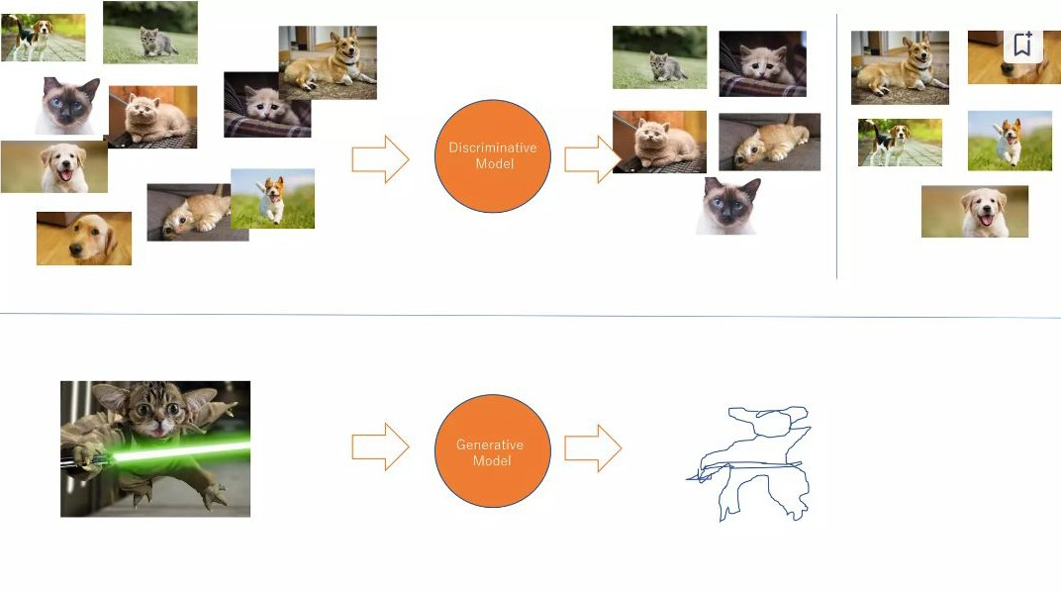

Slide 7
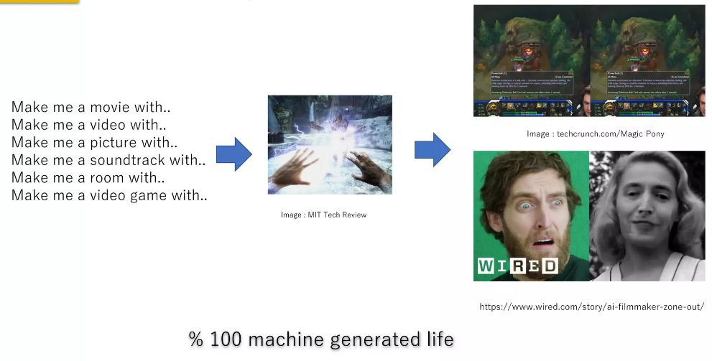
What is Exciting !

Slide 8
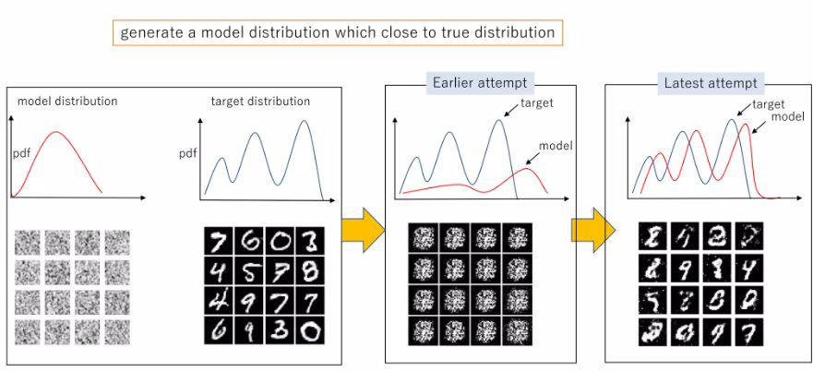
What does Generative Models do?

Slide 9
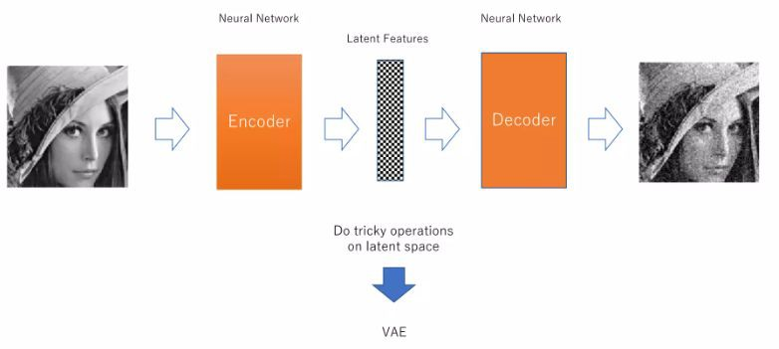
What does Generative Models do?

Slide 10
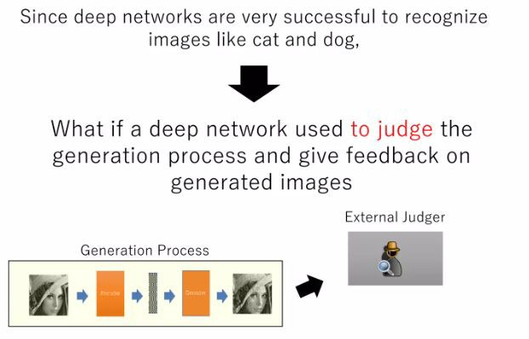
Novel Idea: Adversarial Training

Slide 11
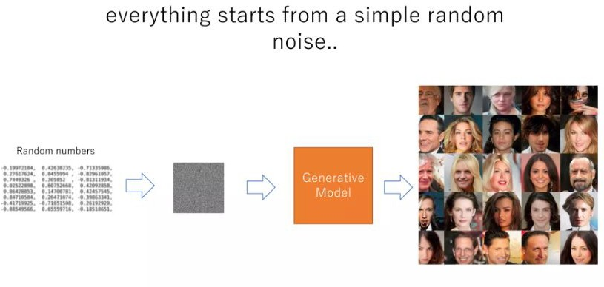
Generative Adversarial Networks

Slide 12
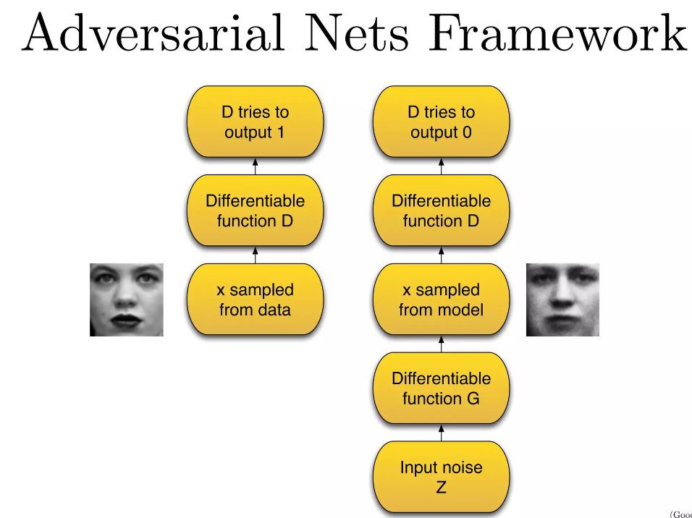

Slide 13
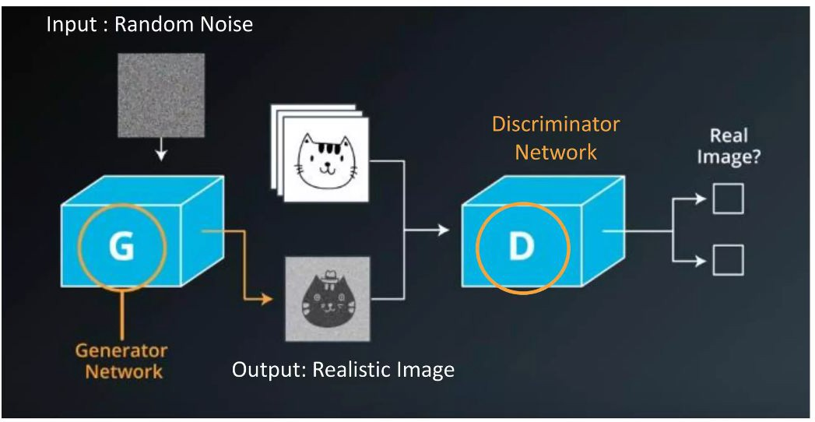
GAN : How does it works?

Slide 14
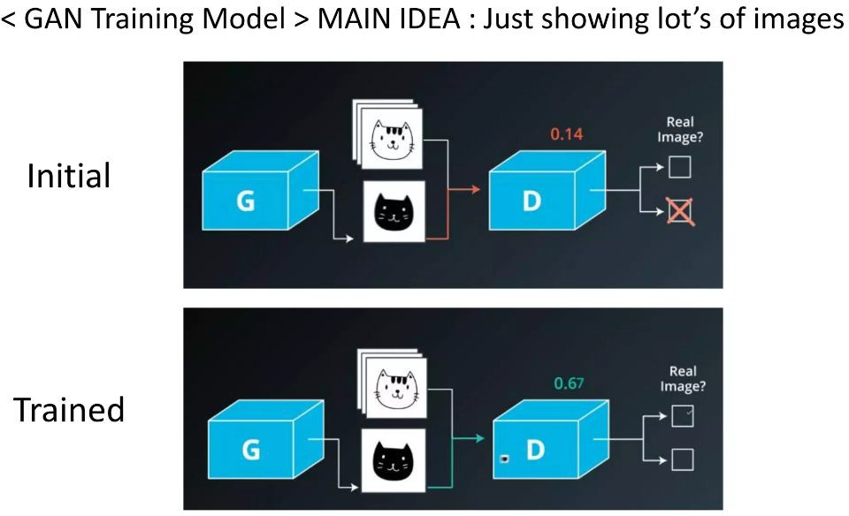
GAN : How does it works?

Slide 15
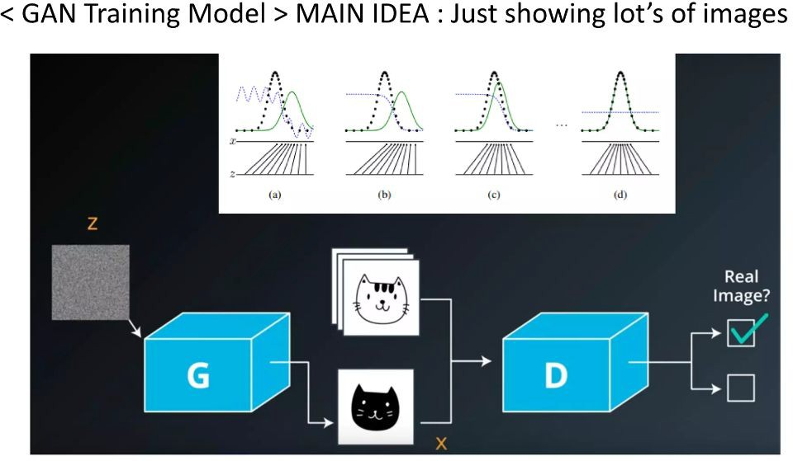
GAN : How does it works?

Slide 16
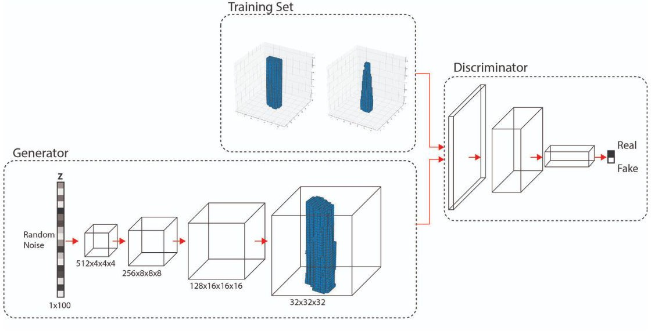
3D Generative Adversarial Networks

Slide 17
3D Generative Adversarial
Generative Adversarial Networks (GANs) are a leading deep generative model that use deep neural networks (DNNs) to learn from a set of training examples in order to create new design instances with a degree of ﬂexibility and ﬁdelity that outperform competing generative approaches. GANs have been used in the creation of 2D designs but their application to 3D synthesis problems has been less explored. This research attempts to ﬁll this gap and explores their use in the synthesis of building forms.
Speciﬁcally, a set of 700 high rise buildings from downtown NYC is used to train a 3D GAN. The GAN is then used to produce new designs. Some examples from this synthesis

Slide 18
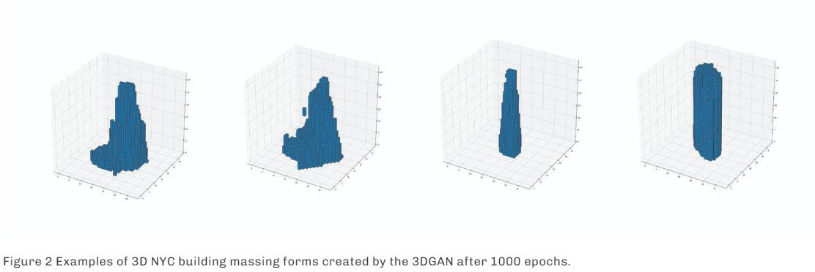
3D Generative Adversarial Networks

Slide 19
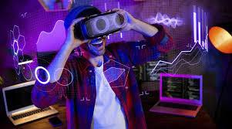
The applications of AI in 3D object generation are vast and multifaceted, spanning numerous industries and
1. Gaming and Virtual Reality (VR):
In the gaming industry, AI-driven 3D object generation has revolutionized content creation pipelines. Game developers can use AI algorithms to generate realistic environments, characters, and assets quickly and efficiently. Moreover, AI-powered procedural generation techniques enable the automatic creation of vast, immersive worlds in virtual reality applications.
creative endeavors.

Slide 20

3D Generative Adversarial Networks
2. Film and Animation: Animators and filmmakers leverage AI to streamline the creation of 3D models for visual effects and animated productions. AI algorithms can generate complex characters, creatures, and environments, reducing the time and resources required for manual modeling. Additionally, AI-driven tools facilitate the creation of lifelike animations by analyzing motion data and generating realistic movements.

Slide 21
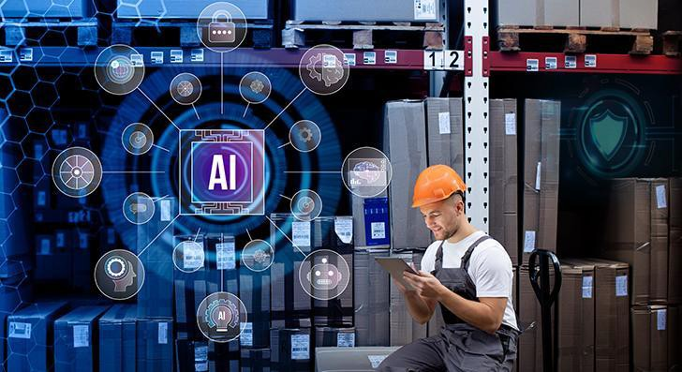
3D Generative Adversarial Networks
3. Industrial Design and Manufacturing: In the realm of industrial design, AI-powered 3D object generation accelerates the product development process. Designers can use AI algorithms to explore countless design variations and optimize product performance and aesthetics. Furthermore,
AI-driven generative design tools help engineers create innovative prototypes and optimize structures for additive manufacturing processes.

Slide 22

3D Generative Adversarial Networks
4. Architecture and Urban Planning: Architects and urban planners employ AI to generate 3D models of buildings, landscapes, and entire cityscapes. AI algorithms can analyze urban data, such as satellite imagery and geographical information, to create accurate representations of existing environments. Moreover, AI-driven design tools aid architects in exploring diverse architectural styles and optimizing building layouts for functionality and sustainability.

Slide 23
Q&A
Questions and answers

Slide 24
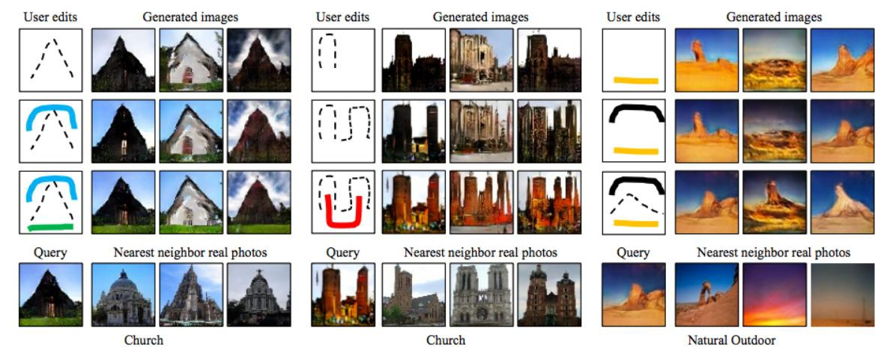
Interactive image
generation
Generative models can be used to create images by interaction. A user can add edits and the images can be generated, reflecting the edits as shown here

Slide 25
Interactive image generation
As shown, the images are generated based on the shape and color of the edits. A green color stroke at the bottom creates a grassland, a rectangle creates a skyscraper and so on. The images will be generated and fine-tuned with further inputs from the user. The generated image can also be used to retrieve the most similar real image that can be utilized

Slide 26
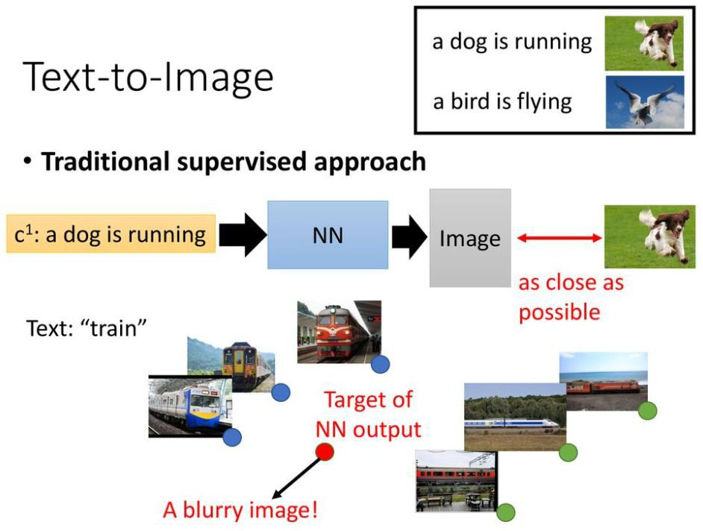
Conditional GAN (cGAN)

Slide 27
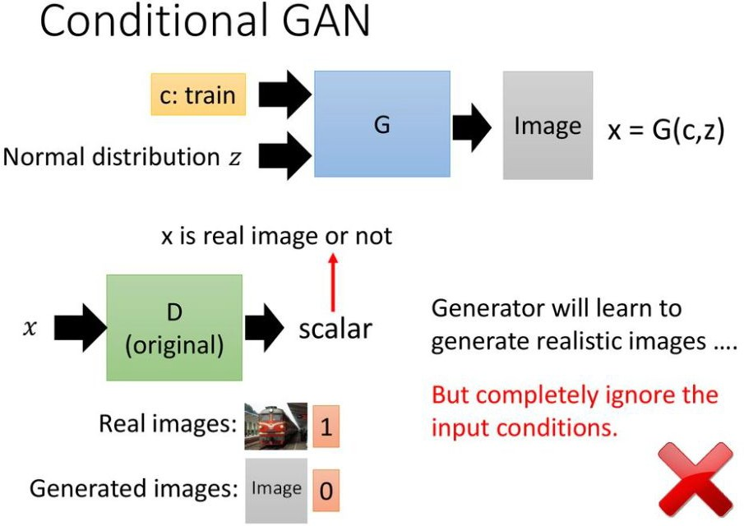

Slide 28
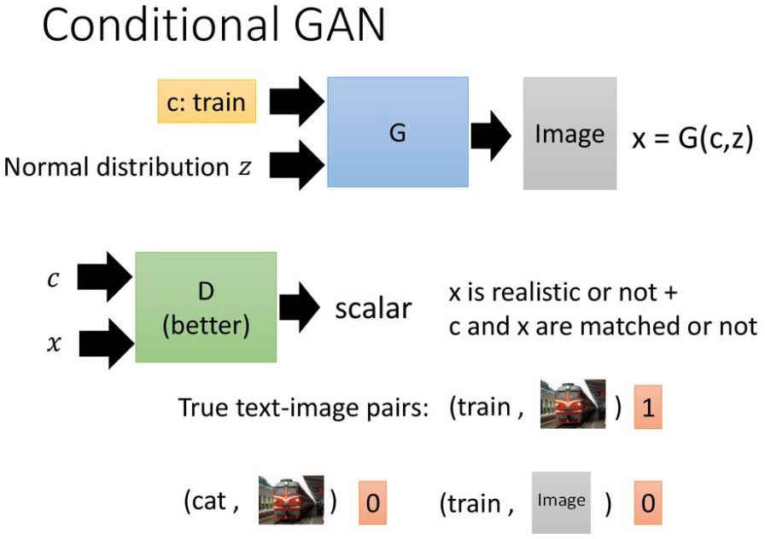

Slide 29
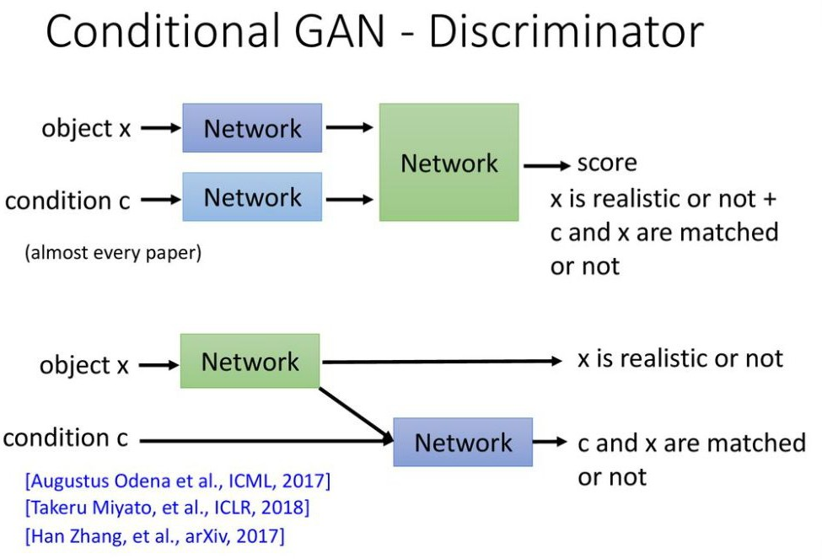

Slide 30
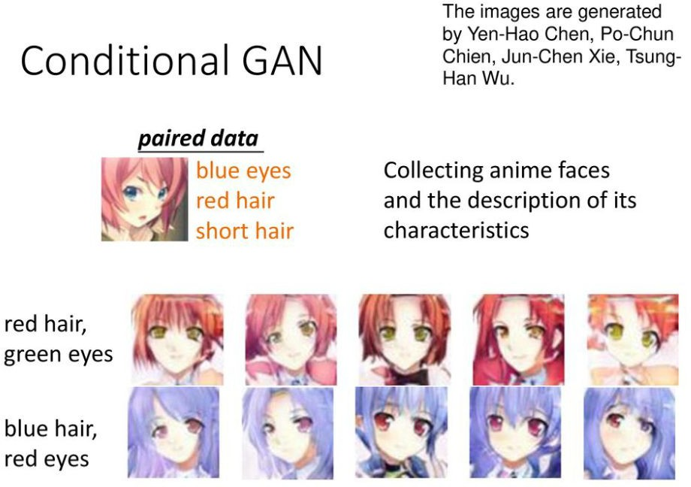

Slide 31
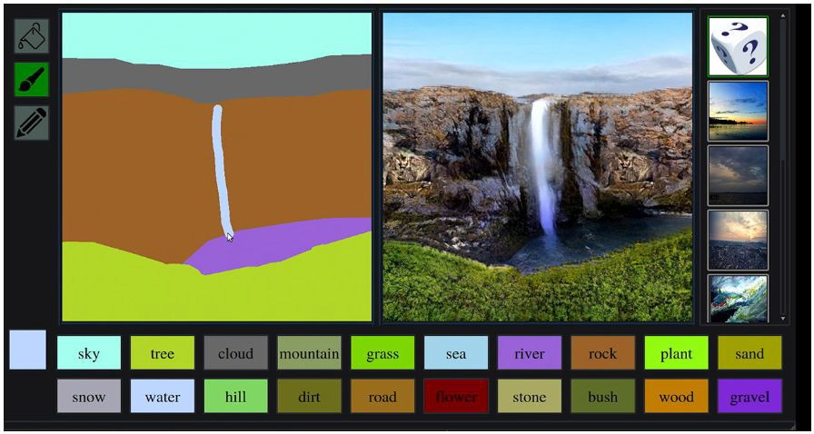
What Is GauGAN?
GauGAN, an AI demo for photorealistic image generation, allows anyone to create stunning landscapes using generative adversarial networks. Named after post-Impressionist painter Paul Gauguin, it was created by NVIDIA Research and can be experienced free through NVIDIA AI Demos.

Slide 32
Architecture of GauGAN
Like any other generative adversarial network, GauGAN contains a discriminator and a generator. With GauGAN speciﬁcally, Nvidia has introduced a new normalization technique called Spatially Adaptive Normalization, or SPADE Normalization, via use of special SPADE blocks. Additionally, GauGAN features an encoder that is used for multi-modal synthesis (if this doesn't make sense, don't worry – we'll cover it later).
The input to the generator consists of:
A one-hot encoded semantic segmentation map
An edge map (optional)
An encoded feature vector (optional)

Slide 33
Architecture of GauGAN
The first is necessary, whereas the second and third inputs are optional. Whichever set of inputs are used, they are
depth-concatenated before being sent to the generator.
The semantic segmentation map is basically one-hot encoded such that we have a one-hot encoded map of each class. These maps are then depth-concatenated.

Slide 34
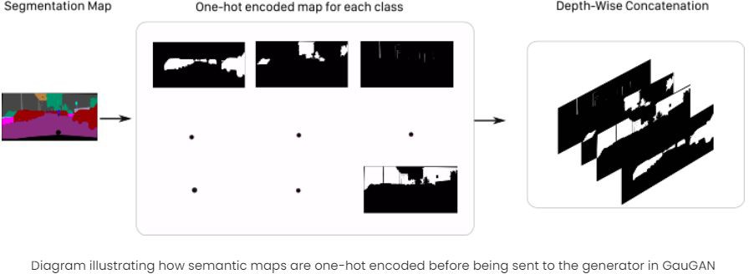

Slide 35
An edge map is only possible if one has instance IDs for objects in the image. In segmentation labels, we only care about the class of the object. If two cars are overlapping, then the car label would be a blob consisting of two overlapping cars. This might confuse the algorithm and cause it to perform worse when two objects are overlapping.
To overcome this, the utilization of a semantic label map was introduced in Pix2PixHD. This is a 0-1 binary map where every pixel is zero except those where each of the four neighbors do not belong to the same instance.
An encoded feature vector is produced by passing the image which will be used as the style guide through the encoder.

Slide 36
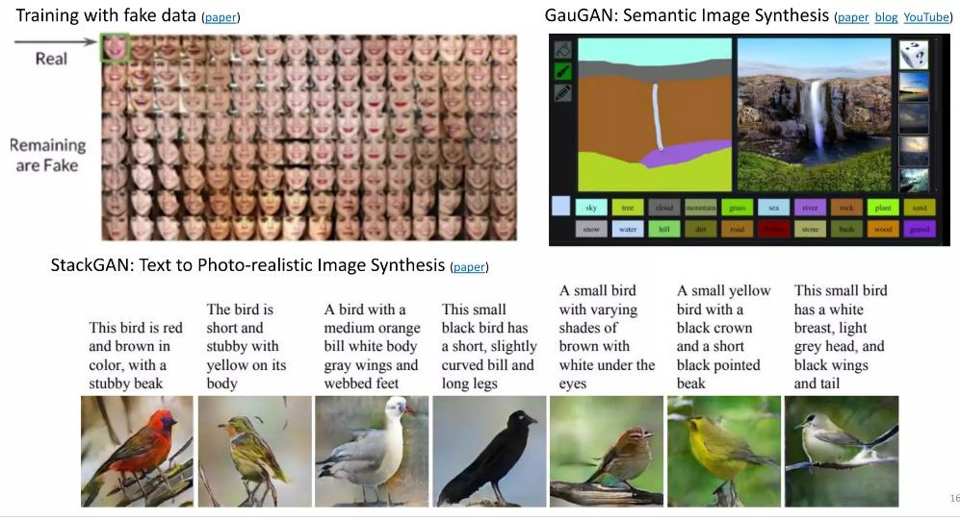
Data Augmentation

Slide 37
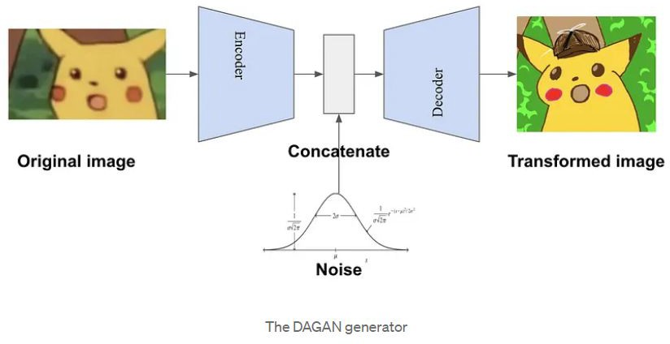
Data Augmentation

Slide 38
Why use GANs for data augmentation?
Generative Adversarial Networks (GANs) can offer many advantages over traditional data augmentation methods, such as generating more diverse and realistic data that preserves semantic and structural features, learning from the latent distribution of the data, handling complex and
high-dimensional data, and addressing the problem of mode collapse. GANs can generate data that traditional techniques cannot, such as faces, texts, or speech, and can be used to augment data that is difficult to work with. Additionally, different architectures or regularization methods can be used to prevent mode collapse.

Slide 39
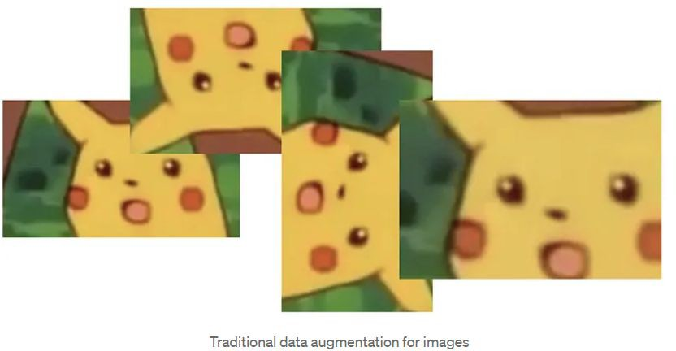
Traditional data augmentation

Slide 40
How to use GANs for data augmentation?
When using GANs for data augmentation, the type and domain of the data, as well as the objectives and constraints of the machine learning task, should all be taken into consideration. Conditional GANs can generate data based on a given condition or label, such as a class or category. CycleGANs can translate data from one domain to another, while StyleGANs can generate data with different styles or attributes. All three approaches can be useful in different scenarios; for instance, Conditional GANs are useful when the data is labeled or has prior information that can guide the generation process, CycleGANs are useful when the data is unpaired or has different modalities or representations, and StyleGANs are useful when the data has multiple and fine-grained variations or characteristics.

Slide 41
What are the challenges of using GANs for data
augmentation?
GANs are not a magic solution for data augmentation, and they come with their own challenges and limitations. Training GANs requires a lot of computational resources and time, especially for large and complex datasets. Additionally, they can suffer from instability and mode collapse, resulting in the generator failing to produce diverse and realistic data or the discriminator becoming too powerful or too weak. Furthermore, GANs can introduce artifacts and noise in the synthetic data or generate data that does not match the distribution or quality of the real data. Finally, ethical and legal issues such as privacy, copyright, or authenticity can arise when generating data involving human subjects or sensitive information.

Slide 42
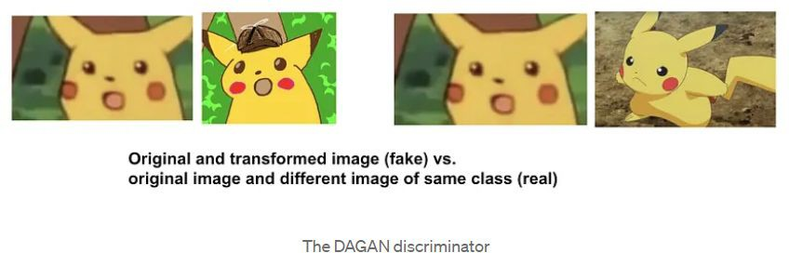
What are the challenges of using GANs for data
augmentation?

Slide 43
How to evaluate GANs for data augmentation?
Evaluating GANs for data augmentation is no easy feat, as there is no definitive metric or criterion to measure their performance and effectiveness. Visual inspection is the simplest and most intuitive way to evaluate GANs for data augmentation, allowing one to observe the quality, diversity, and realism of the synthetic data. Quantitative metrics are another option, which involve numerical measures to quantify some aspects of the synthetic data. However, these metrics can be unreliable or inconsistent, and may not capture the semantic or structural features of the data. Finally, downstream tasks are the ultimate and most practical way to evaluate GANs for data augmentation, as they measure the impact and usefulness of the synthetic data on a machine learning model's performance.

Slide 44
Q&A
Questions and answers

Slide 45
Thanks

